Slide 1
Module3_Games_Mini-max_algorithm
Reference: Russell, S. and Norvig, P. Artificial Intelligence - A Modern Approach, 4th edition, Prentice Hall, 2020-Chapter 5, section 5.1 and 5.2

Slide 2
Introduction
In a competitive environments, two or more agents have conflicting goals, giving rise to adversarial search problems.
Rather than deal with the chaos of real-world skirmishes, we will concentrate on games, such as chess, Go, and poker.
AI researchers take over on the simplified nature of these games:
the state of a game is easy to represent, and agents are usually restricted to a small number of actions whose effects are defined by precise rules.

Slide 3
Adversarial search
Adversarial search is a search, where we examine the problem which arises when we try to plan ahead of the world and other agents are planning against us.
It is a search when there is an "enemy" or "opponent" changing the state of the problem at every step in a direction you do not want.
Examples: Chess, business, trading, war.
Heuristic search refers to a search strategy that attempts to optimize a problem by iteratively improving the solution based on a given heuristic function or a cost measure.
A classic example of applying heuristic search is the traveling salesman problem

Slide 4
Game Theory
Game playing is one of the oldest sub-field of AI.
Game playing involves abstract and pure form of competition that seems to require intelligence.
It is easy to represent the state and actions
To implement game playing one requires very little world knowledge

Slide 5
Game Theory
The most commonly used AI technique in game is search
Game playing research has contributed ideas on how to make the best use of time to reach good decisions
Game playing is a search problem defined by:
Initial state of the game
Operators defining legal moves
Successor function
Terminal test defining end of game states
Goal test
Path cost/ utility/ payoff function

Slide 6
Two-player zero-sum games
The games most commonly studied within AI (such as chess and Go) are what game theorists call deterministic, two-player, turn-taking, perfect information, zero-sum games.
“Perfect information” is a synonym for “fully observable,”
“zero-sum” means that what is good for one player is just as bad for the other: there is no “win-win” outcome.
For games we often use the term move as a synonym for “action” and position as a synonym for “state.”

Slide 7
Two-player zero-sum games
We will call our two players MAX and MIN
MAX moves first, and then the players take turns moving until the game is over.
At the end of the game, points are awarded to the winning player and penalties are given to the loser.
A game can be formally defined with the following elements:
The initial state S0, which specifies how the game is set up at the start.
TO-MOVE (s) : The player whose turn it is to move in state s .
ACTIONS (s) : The set of legal moves in state s.
IS-TERMINAL(s) : A terminal test, which is true when the game is over and false otherwise.
States where the game has ended are called terminal states.
RESULT (s,a) : The transition model, which defines the state resulting from taking action a in state s.
UTILITY (s,p): A utility function (also called an objective function or payoff function), which defines the final numeric value to player p when the game ends in terminal state s.
In chess, the outcome is a win, loss, or draw, with values 0, 1 or ½.
Some games have a wider range of possible outcomes—for example, the payoffs in backgammon range from 0 to 192.

Slide 8
Two-player zero-sum games
Chess is considered a “zero-sum” game, even though the sum of the outcomes for the two players is +1 for each game, not zero.
“Constantsum” would have been a more accurate term, but zero-sum is traditional and makes sense if one imagines each player is charged an entry fee of 1/2.
The initial state, ACTIONS function, and RESULT function define the state space graph—a graph where the vertices are states, the edges are moves and a state might be reached by multiple paths.
A complete game tree is presented as a search tree that follows every sequence of moves all the way to a terminal state.
The game tree may be infinite if the state space itself is unbounded or if the rules of the game allow for infinitely repeating positions.

Slide 9
Game Tree Example
Part of the game tree for tic-tac-toe (noughts and crosses).
From the initial state, MAX has nine possible moves.
Play alternates between MAX’s placing an X and MIN’s placing an O until we reach leaf nodes corresponding to terminal states such that one player has three squares in a row or all the squares are filled.
The number on each leaf node indicates the utility value of the terminal state from the point of view of MAX; high values are good for MAX and bad for MIN (which is how the players get their names).

Slide 10
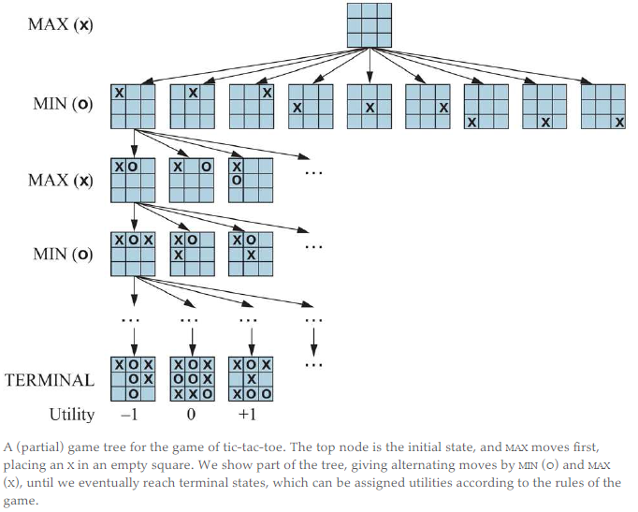
Game Tree Example
Example:

Slide 11
Game Tree Example
For tic-tac-toe the game tree is relatively small—fewer than 9! = 362,880 terminal nodes
the game tree is best thought of as a theoretical construct that we cannot realize in the physical world.

Slide 12
Optimal Decisions in Games
MAX wants to find a sequence of actions leading to a win, but MIN has something to say about it.
This means that MAX’s strategy must be a conditional plan—a contingent strategy specifying a response to each of MIN’s possible moves.
In games that have a binary outcome (win or lose), we could use AND–OR search to generate the conditional plan.
In fact, for such games, the definition of a winning strategy for the game is identical to the definition of a solution for a nondeterministic planning problem: in both cases the desirable outcome must be guaranteed no matter what the “other side” does.
For games with multiple outcome scores, we need a slightly more general algorithm called minimax search.

Slide 13
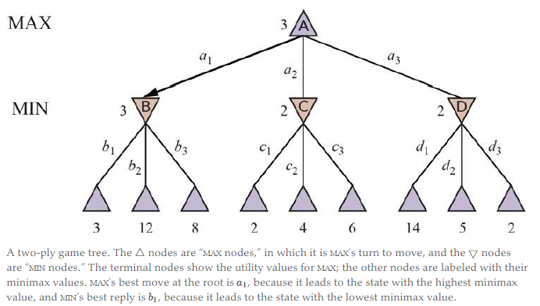
Example
Example: Figure 5.2

Slide 14
Example cont’d
The possible moves for MAX at the root node (as in previous slide) are labeled a1, a2, and a3.
The possible replies to a1 for MIN are b1, b2,b3 and so on.
This particular game ends after one move each by MAX and MIN.
NOTE: In some games, the word “move” means that both players have taken an action; therefore the word ply is used to unambiguously mean one move by one player, bringing us one level deeper in the game tree.
The utilities of the terminal states in this game range from 2 to 14.

Slide 15
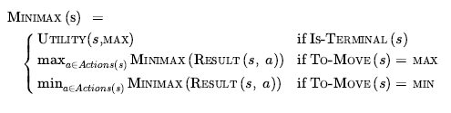
Optimal Decisions in Games
Given a game tree, the optimal strategy can be determined by working out the minimax value of each state in the tree, which we write as MINIMAX(s).
The minimax value is the utility (for MAX) of being in that state, assuming that both players play optimally from there to the end of the game.
The minimax value of a terminal state is just its utility.
In a non-terminal state, MAX prefers to move to a state of maximum value when it is MAX’s turn to move, and MIN prefers a state of minimum value (that is, minimum value for MAX and thus maximum value for MIN). So we have:

Slide 16
Example

Slide 17
Optimal Decisions in Games
Let us apply these definitions to the game tree in Figure 5.2 .
The terminal nodes on the bottom level get their utility values from the game’s UTILITY function.
The first MIN node, labelled B, has three successor states with values 3, 12, and 8, so its minimax value is 3.
Similarly, the other two MIN nodes have minimax value 2.
The root node is a MAX node; its successor states have minimax values 3, 2, and 2; so it has a minimax value of 3.
We can also identify the minimax decision at the root: action a1 is the optimal choice for MAX because it leads to the state with the highest minimax value.

Slide 18
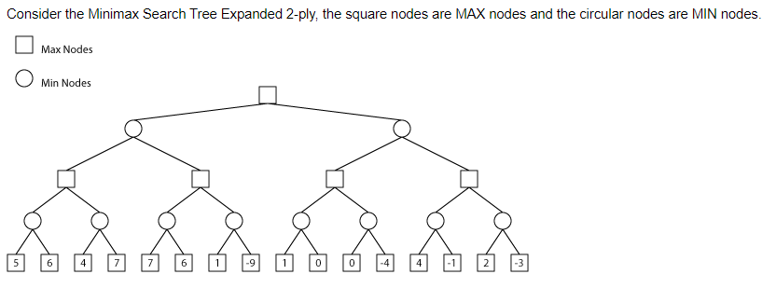
Optimal Decisions in Games
Example:

Slide 19
Optimal Decisions in Games
The definition of optimal play for MAX assumes that MIN also plays optimally.
What if MIN does not play optimally?
Then MAX will do at least as well as against an optimal player, possibly better.
However, that does not mean that it is always best to play the minimax optimal move when facing a suboptimal opponent.
Consider a situation where optimal play by both sides will lead to a draw, but there is one risky move for MAX that leads to a state in which there are 10 possible response moves by MIN that all seem reasonable, but 9 of them are a loss for MIN and one is a loss for MAX.
If MAX believes that MIN does not have sufficient computational power to discover the optimal move, MAX might want to try the risky move, on the grounds that a 9/10 chance of a win is better than a certain draw.

Slide 20
The minimax search algorithm
Now that we can compute MINIMAX(s), we can turn that into a search algorithm that finds the best move for MAX by trying all actions and choosing the one whose resulting state has the highest MINIMAX value.
Figure 5.3 shows the algorithm.
It is a recursive algorithm that proceeds all the way down to the leaves of the tree and then backs up the minimax values through the tree as the recursion unwinds.
For example, in Figure 5.2 , the algorithm first recurses down to the three bottom-left nodes and uses the UTILITY function on them to discover that their values are 3, 12, and 8, respectively.
Then it takes the minimum of these values, 3, and returns it as the backed-up value of node .
A similar process gives the backed-up values of 2 for C and 2 for D.
Finally, we take the maximum of 3, 2, and 2 to get the backed-up value of 3 for the root node.

Slide 21
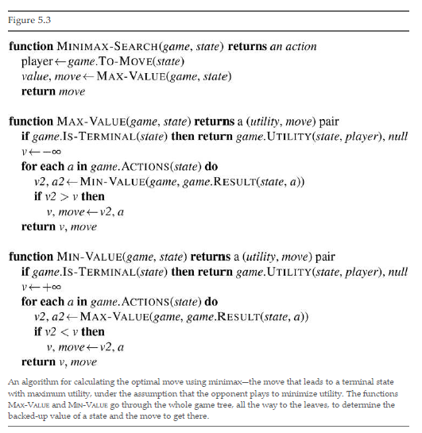
The minimax search algorithm
Algorithm:

Slide 22
The minimax search algorithm

Slide 23
Minimax search - properties
The minimax algorithm performs a complete depth-first exploration of the game tree.
If the maximum depth of the tree is m and there are b legal moves at each point, then the time complexity of the minimax algorithm is O(b^{m}).
The space complexity is O(bm) for an algorithm that generates all actions at once, or O(m) for an algorithm that generates actions one at a time.
The exponential complexity makes MINIMAX impractical for complex games; for example, chess has a branching factor of about 35 and the average game has depth of about 80 ply, and it is not feasible to search states.
MINIMAX does, however, serve as a basis for the mathematical analysis of games.
By approximating the minimax analysis in various ways, we can derive more practical algorithms.

Slide 24
Minimax search - properties
Complete: Yes (if tree is finite)
Optimal: Yes (against an optimal opponent)
Time complexity: O(b^{m})
Space complexity: O(bm) (depth-first exploration)

